Slide 1
Milestone 2: IT Ticketing Database System

Slide 2
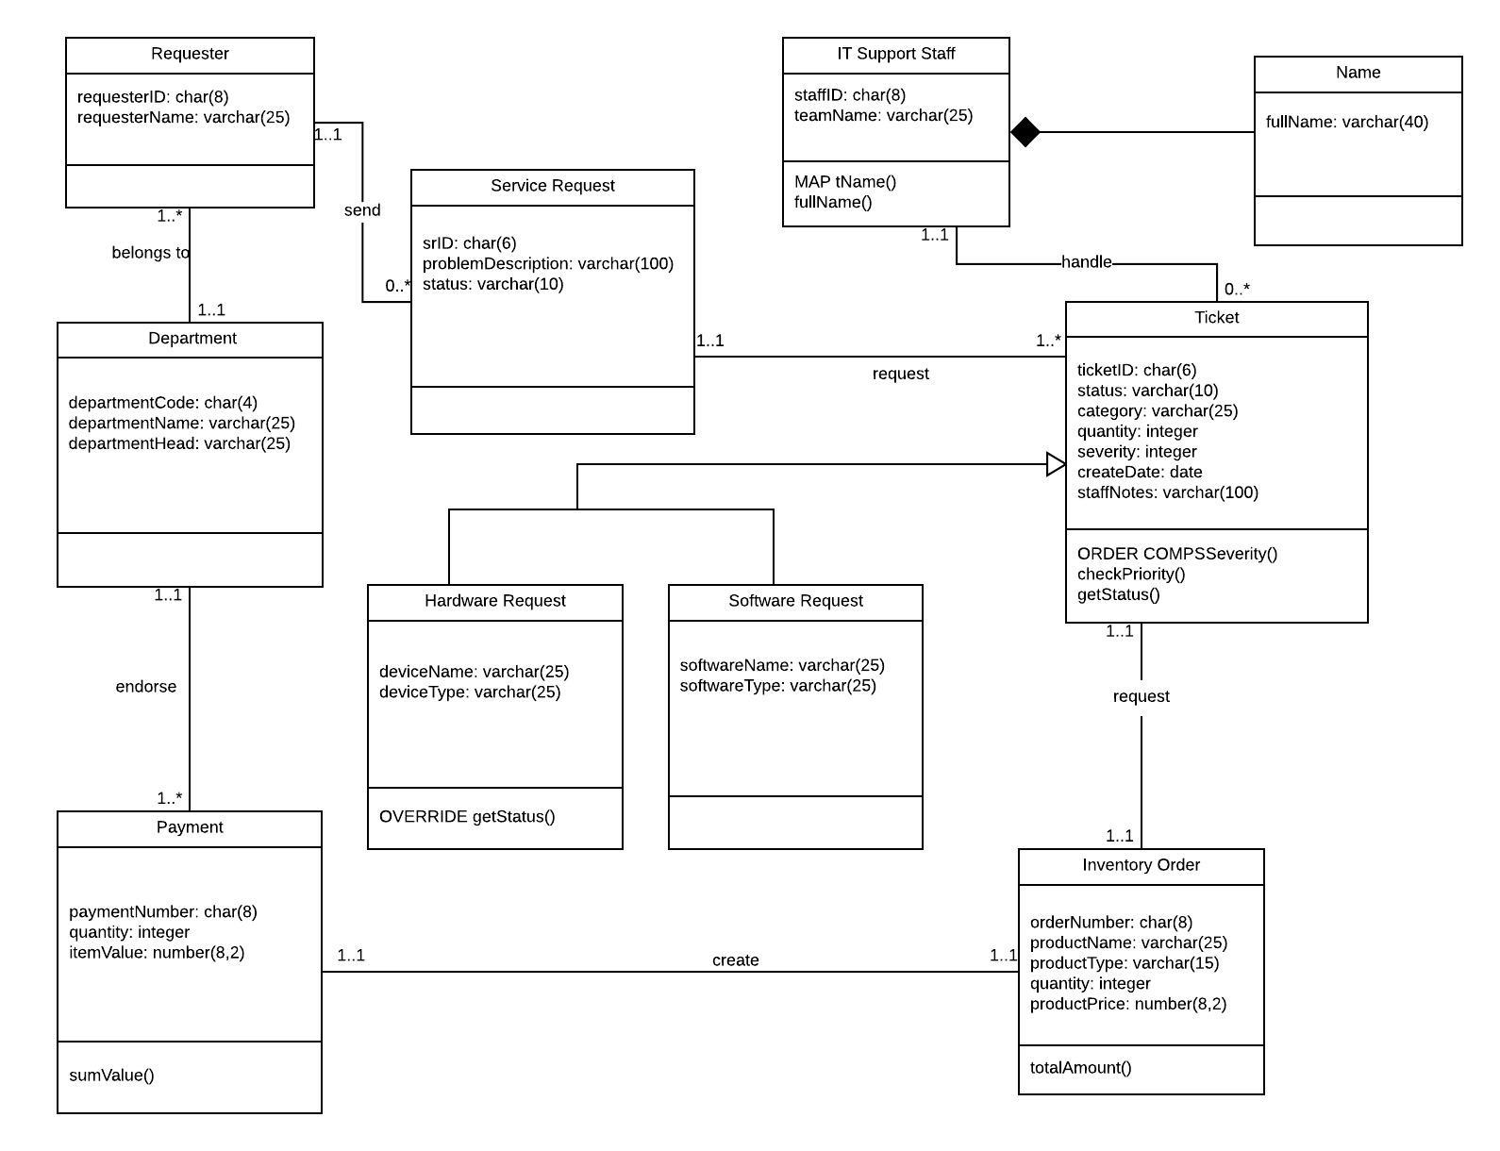
Modified Class Diagram

Slide 3
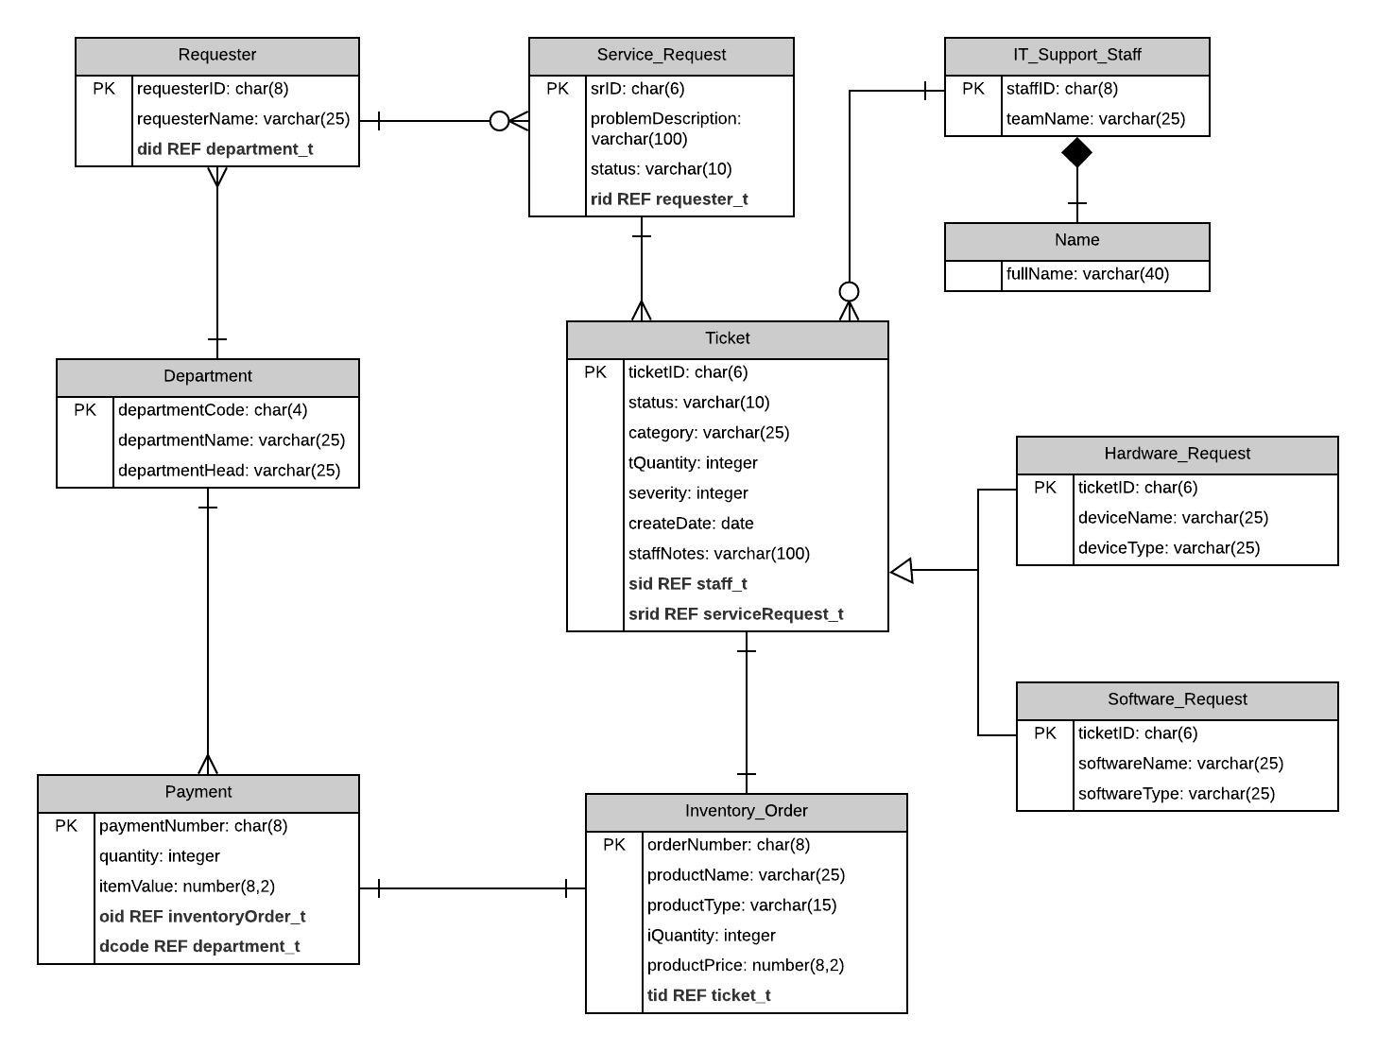
Logical Database Schema

Slide 4
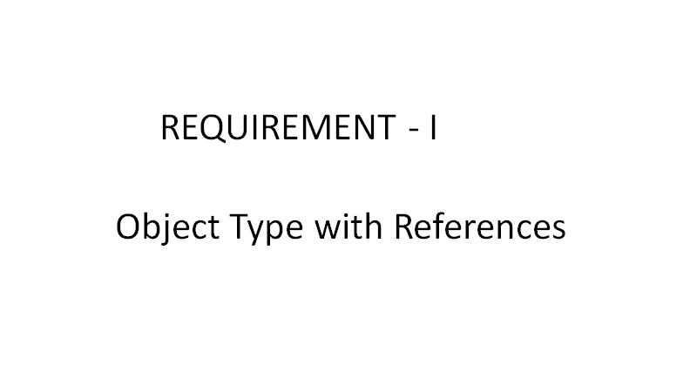

Slide 5
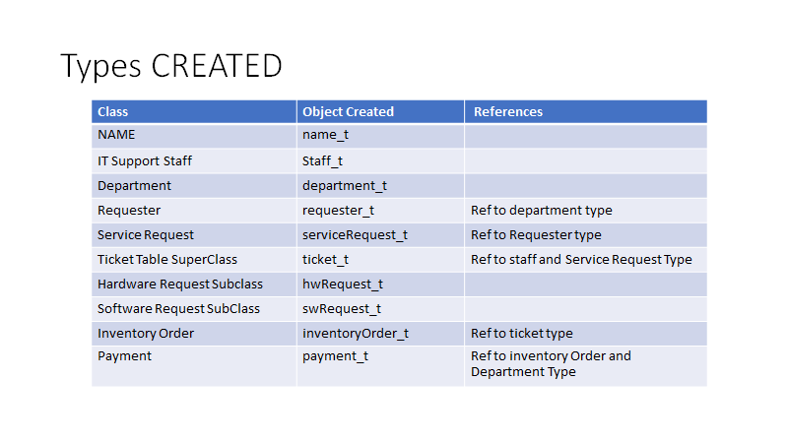

Slide 6
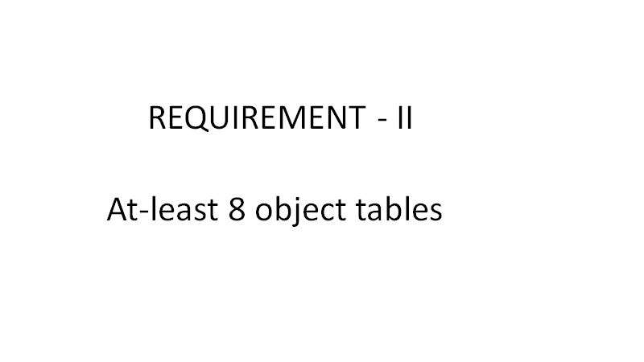

Slide 7
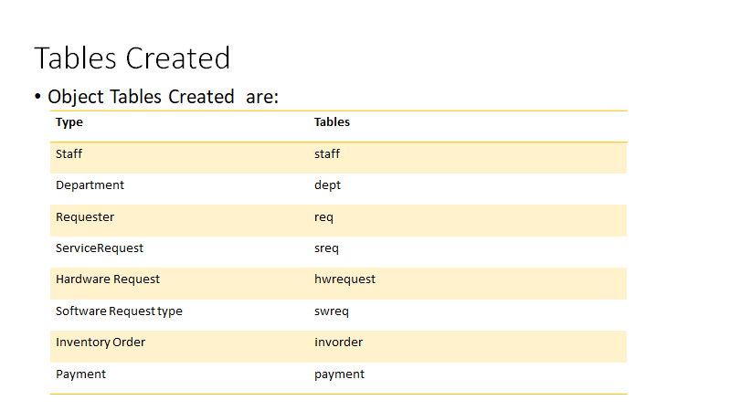

Slide 8
Query 1
Find the department head's name who needs to endorse the payment with number pn000039.
SQL> select p.dcode.departmentHead from payment p where p.paymentNumber='pn000039';
Result
DCODE.DEPARTMENTHEAD
-------------------------
Allen Todd

Slide 9
Query 2
List all the staff ID and name who process hardware request tickets.
SQL> select h.sid.staffID, h.sid.fullName() from hwRequest h;
Result
SID.STAF
--------
H.SID.FULLNAME()
--------------------------------------------------------------------------------
hws00009
Emma Wanson
hws00009
Emma Wanson
bps00006
Adam Collin

Slide 10
Query 3
List all the requester Name and their department code for whose service request is created as a hardware request ticket.
SQL> select h.srid.rid.requesterName, h.srid.rid.did.departmentCode from hwRequest h;
Result
SRID.RID.REQUESTERNAME SRID
------------------------- ----
Kate Wiley SAMT
Ally Marks SAMT
Peter Logan OPWH

Slide 11
Query 4
List department name and their each corresponding inventory order total amount.
SQL> select p.dcode.departmentName, p.oid.totalAmount() from payment p;
Result
DCODE.DEPARTMENTNAME P.OID.TOTALAMOUNT()
------------------------- -------------------
sales and marketing 220
operation and warehouse 598
customer service 70

Slide 12
Query 5
Find problem description and status of the service request made by requester Peter Logan.
select s.rid.RequesterName, s.problemDescription, s.srStatus from sreq s where s.rid.requesterName='Peter Logan';
RID.REQUESTERNAME PROBLEMDESCRIPTION SRSTATUS
-----------------------------------------------------------------------------------------------------
Peter Logan screen monitor doesnot work well solved

Slide 13
Query 6
Find departments who are having issues with the monitor. As problem description is inserted by requesters in plain english so find for any mention of word “monitor” in their problem description.
select s.rid.did.departmentName, s.problemDescription from sreq s where s.problemDescription like '%monitor%';
RID.DID.DEPARTMENTNAME PROBLEMDESCRIPTION
--------------------------------------------------------------------------------
operation and warehouse screen monitor doesnot work well
customer service Glitch in the monitor

Slide 14
Query 7
Find the requesters and their departments who have made any payment exceeding $ 500.
select p.oid.tid.srid.rid.requesterName , p.paymentNumber from payment p where p.itemValue>500;
OID.TID.SRID.RID.REQUESTE PAYMENTN
------------------------- --------
Peter Logan pn000119

Slide 15
Query 8
Display how many requesters each department has.
SQL> select r.did.departmentName , count(r.requesterId) from req r group by r.did.departmentName;
DID.DEPARTMENTNAME COUNT(R.REQUESTERID)
------------------------- --------------------
customer service 2
sales and marketing 2
operation and warehouse 1

Slide 16
Query 9
(MAP) List full name of IT staff member and all their tickets that have been solved according to the order of severity.
SQL> select h.sid.fullname(), h.ticketid, h.status, s.sid.fullname(), s.ticketid, s.status from hwrequest h, swreq s where h.status = 'solved' and s.status = 'solved' order by value(s);
H.SID.FULLNAME()
--------------------------------------------------------------------------------
TICKET STATUS
------ ----------
S.SID.FULLNAME()
--------------------------------------------------------------------------------
TICKET STATUS
------ ----------
Adam Collin
T00021 solved
Emma Wanson
T00002 solved

Slide 17
Query 10
(ORDER Method) all IT staff members names by their team names and the software tickets they are assigned to.
SQL> Select s.sname, sw.ticketid from staff s, swreq sw order by value(s) desc;

Slide 18
TICKET
------
NAME_T('John Smith')
T00032
business process team
NAME_T('John Smith')
T00022
TEAMNAME
-------------------------
SNAME(FULLNAME)
--------------------------------------------------------------------------------
TICKET
------
business process team
NAME_T('John Smith')
T00002
business process team
NAME_T('John Smith')
T00012
TEAMNAME
-------------------------
SNAME(FULLNAME)
--------------------------------------------------------------------------------
TICKET
------
TICKET
------
NAME_T('Emma Wanson')
T00012
hardware support team
NAME_T('Emma Wanson')
T00002
TEAMNAME
-------------------------
SNAME(FULLNAME)
--------------------------------------------------------------------------------
TICKET
------
hardware support team
NAME_T('Emma Wanson')
T00032
business process team
NAME_T('Adam Collin')
T00032
TEAMNAME
-------------------------
SNAME(FULLNAME)
--------------------------------------------------------------------------------
TICKET
------
business process team
NAME_T('Adam Collin')
T00022
business process team
NAME_T('Adam Collin')
TEAMNAME
-------------------------
SNAME(FULLNAME)
--------------------------------------------------------------------------------
TICKET
------
T00012
business process team
NAME_T('Adam Collin')
T00002
business process team
TEAMNAME
-------------------------
SNAME(FULLNAME)
--------------------------------------------------------------------------------

Slide 19
Query 11
(Overriding Method) List the status of a current ticket involving a hardware mouse update.
select p.sumValue(), treat(p.oid.tid as ref hwRequest_t).getStatus() from payment p where treat(p.oid.tid as ref hwRequest_t).devicename ='mouses';
P.SUMVALUE()
------------
TREAT(P.OID.TIDASREFHWREQUEST_T).GETSTATUS()
--------------------------------------------------------------------------------
220
new,for Hardware only

Slide 20
Query 12
(From Prof) Find the names of the departments whose employees requested software MATLAB.
SQL> select s.srid.rid.did.departmentName from swreq s where s.softwareName='MATLAB';
SRID.RID.DID.DEPARTMENTNA
-------------------------
sales and marketing

